Slide 1


CI-CD Assignment
Presented By: Paras Jain
Emp. No: 1589
Notes:
Note: First “Right Click” on the Gradient background, go to “Order” option and “Send it to Back”, then insert your picture into “Image Placeholder”, “Right Click” on the picture and again go to “Order” option and “Send it to Back” to get the “Gradient” effect.

Slide 2

Platform Used
AWS Instance
It is a cloud computing web services provide a variety of basic abstract technical infrastructure and distributed computing building blocks and tools.
Jenkins
Jenkins is a self-contained, open source automation server which can be used to automate all sorts of tasks related to building, testing, and delivering or deploying software.
Github
GitHub is a Git repository hosting service, but it adds many of its own features. While Git is a command line tool, GitHub provides a Web-based graphical interface.
NPM
npm is a package manager for the JavaScript programming language maintained by npm, Inc. npm is the default package manager for the JavaScript runtime environment Node.js.

Slide 3

Our Agenda
Tasks to be Performed
01
Create a Jenkins pipeline to deploy application present at: https://github.com/knoldus/node-hello
02
Required command to run the application and the ports being used are present in the Github repository.
03
You are required to use Jenkins Freestyle project to set this pipeline.
04
The ports of the application should be open for communication and accept connection on the host machine.
05
The validations can be performed by hitting endpoints: <VM_IP>:3000 or <VM_IP>:3001

Slide 4
Things to Remember
Jenkins should be set up on a Cloud Virtual Machine and not from the local system.
Any commits to the ‘main’ branch should trigger the job on Jenkins and start the build process.
Use Poll SCM triggers.
The first part of the Jenkins job should be creating the package.
The second part of the Jenkins job will be to send the package to another VM and run it there.

Slide 5
Introduction
Information about Platform Used
Amazon AWS
Jenkins
Amazon Web Services, Inc. (AWS) is a subsidiary of Amazon providing on-demand cloud computing platforms and APIs to individuals, companies, and governments, on a metered pay-as-you-go basis. These cloud computing web services provide a variety of basic abstract technical infrastructure and distributed computing building blocks and tools. One of these services is Amazon Elastic Compute Cloud (EC2), which allows users to have at their disposal a virtual cluster of computers, available all the time, through the Internet.
Jenkins is a self-contained, open source automation server which can be used to automate all sorts of tasks related to building, testing, and delivering or deploying software.
Jenkins can be installed through native system packages, Docker, or even run standalone by any machine with a Java Runtime Environment (JRE) installed.

Slide 6
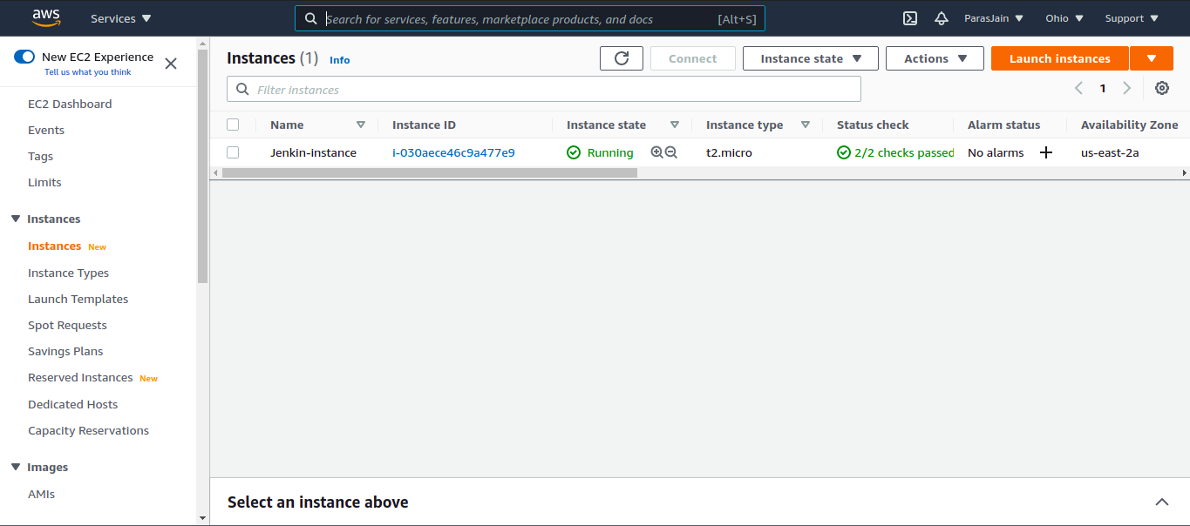
AWS Instance
Used to Launch a new Instance.

Slide 7
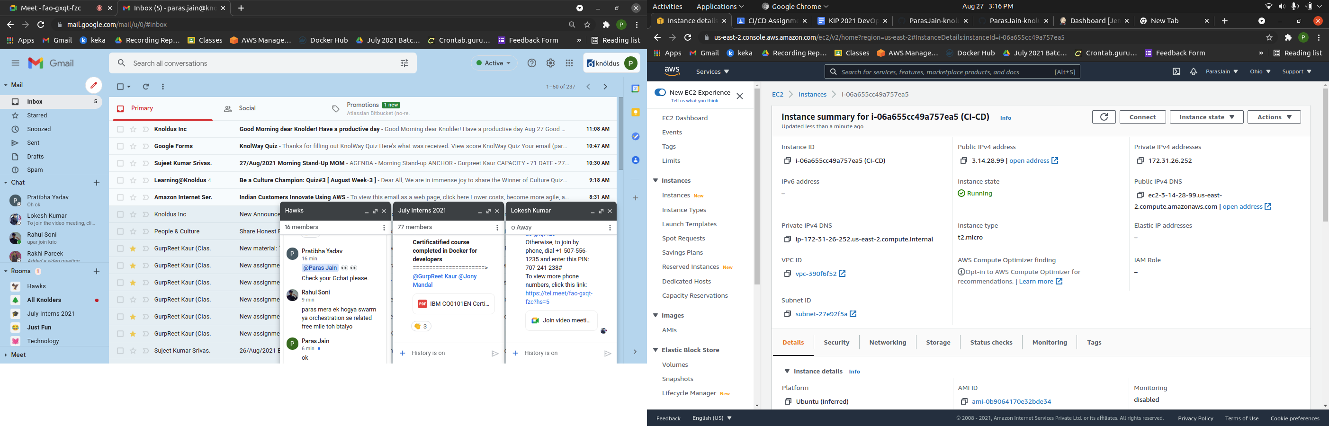
Instance Summary
This is Instance IP Address

Slide 8
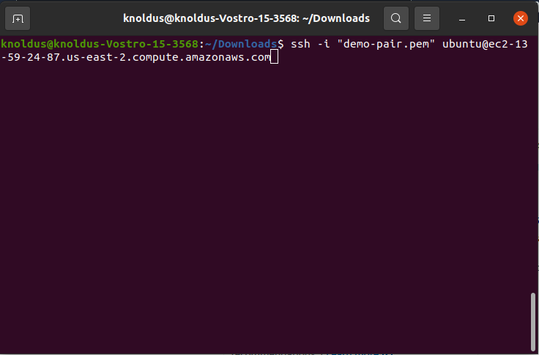
Connecting to CVM
This command is used to enter the CVM
(Cloud Virtual Machine)

Slide 9
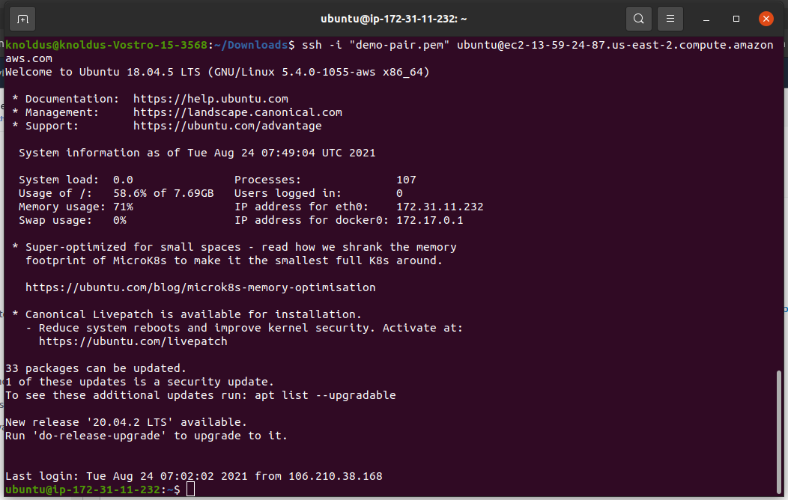
Now you are in the CVM.

Slide 10
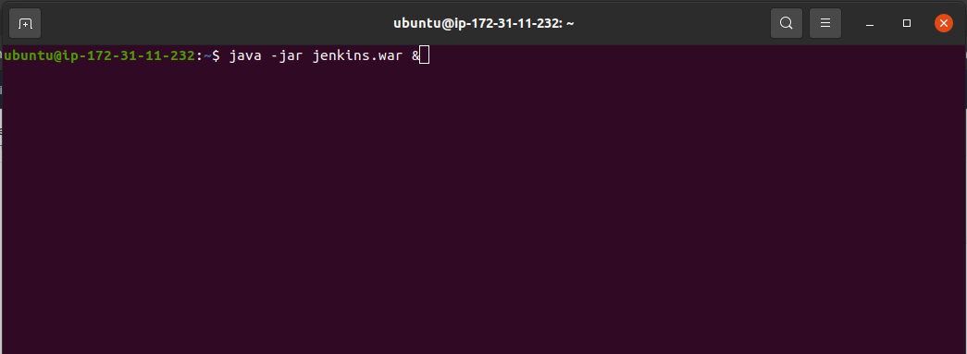
Connecting to Jenkins
This command is used to start the Jenkins Server and “&” is used to run it in the background.

Slide 11
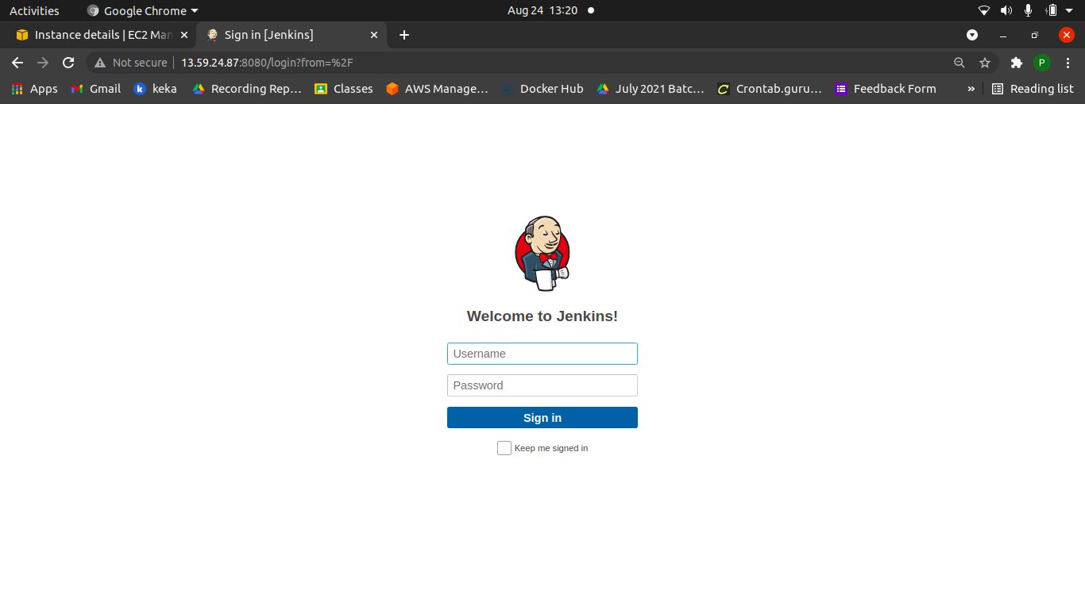
Jenkin Login Dashboard
This is Jenkins port address.

Slide 12
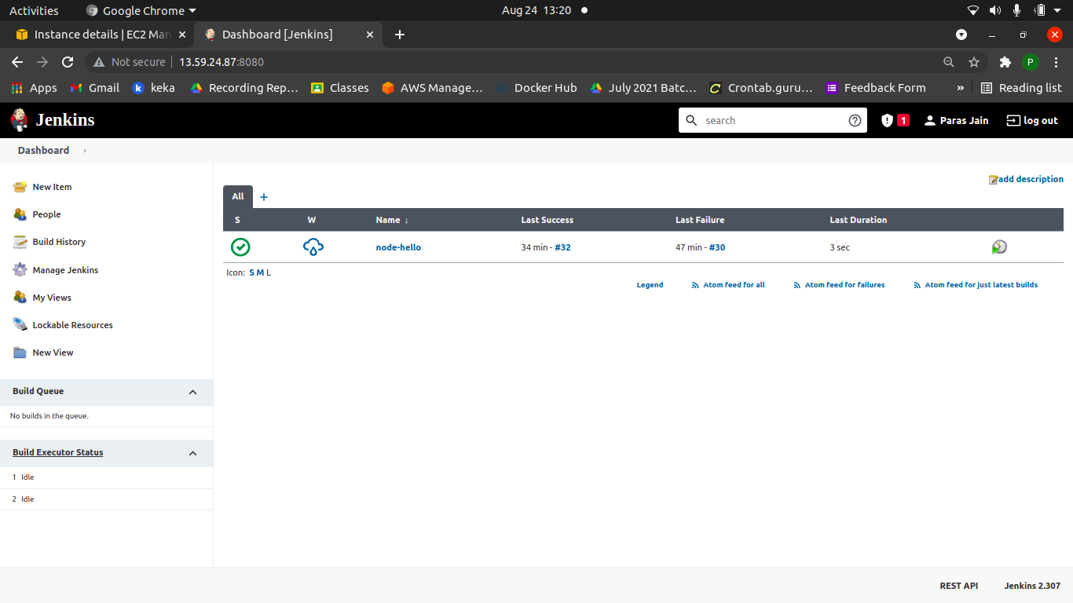
Jenkin Dashboard
Used to add a New Jenkins Project.

Slide 13
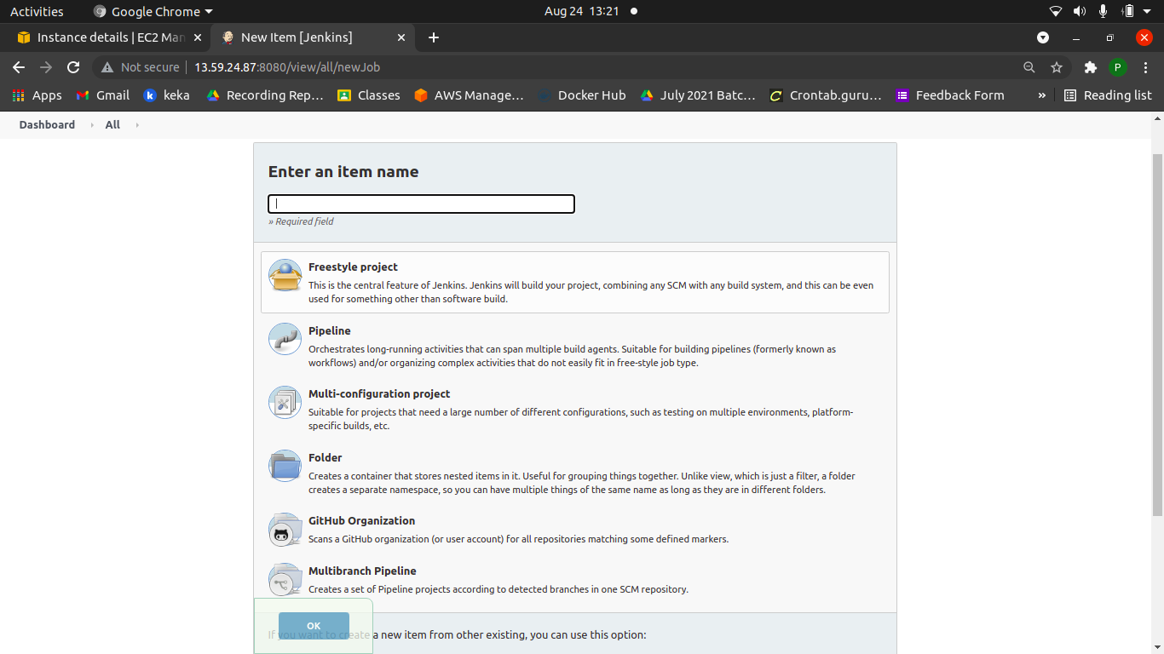
Creating a New Jenkin Pipeline
We have to choose free style project.
Different Types of Jenkins Project.

Slide 14
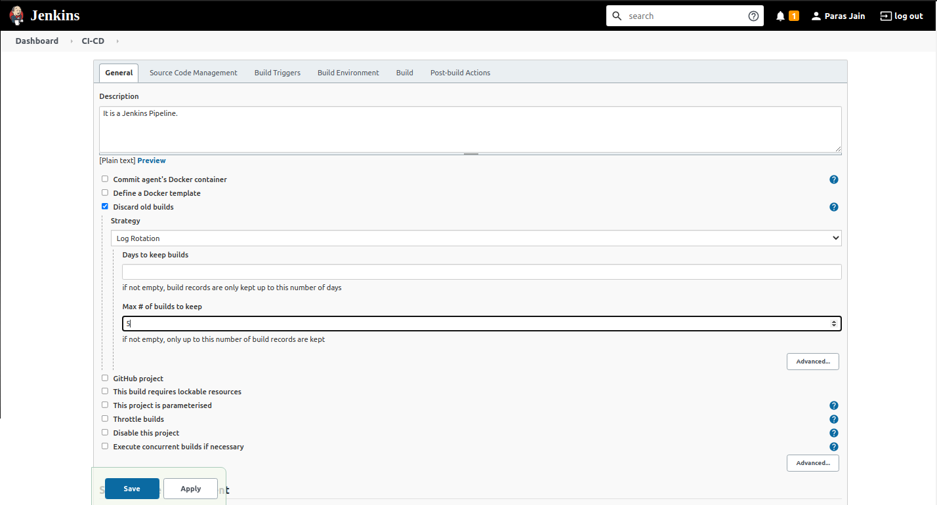
Pipeline Configuration
Used to Discard the old builds.

Slide 15
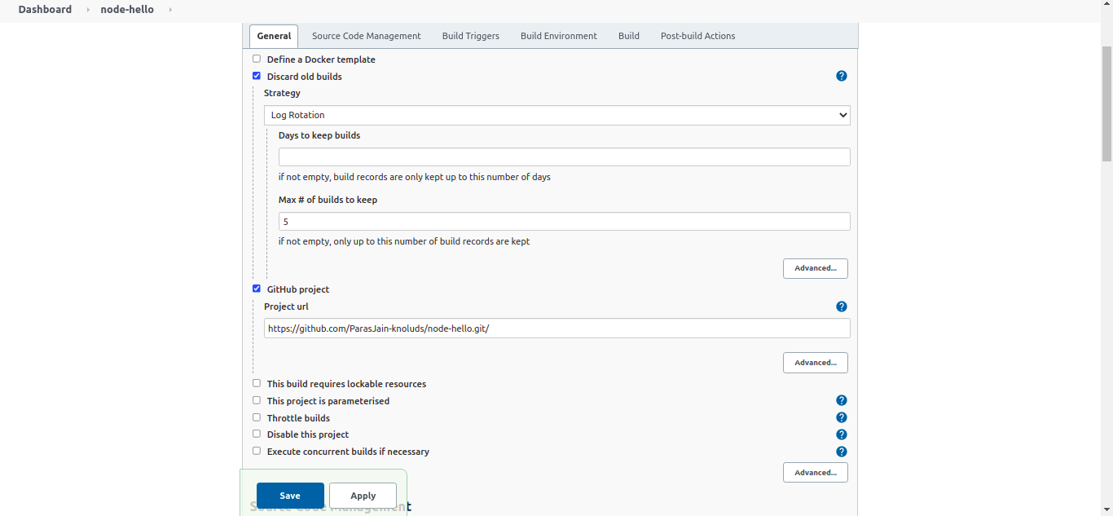
Github URL

Slide 16
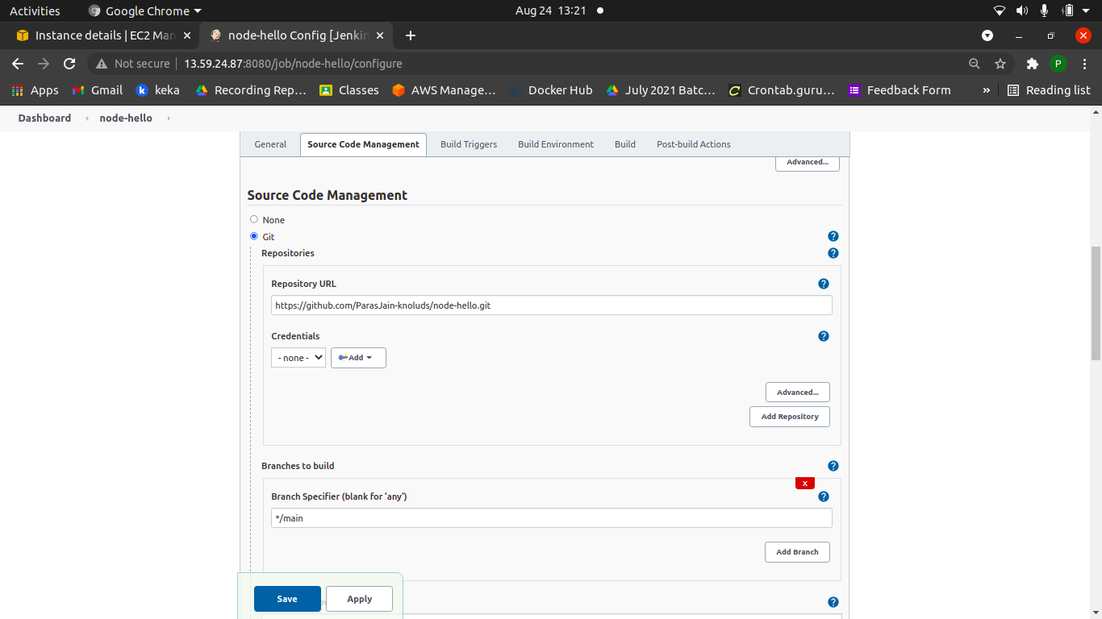

Slide 17
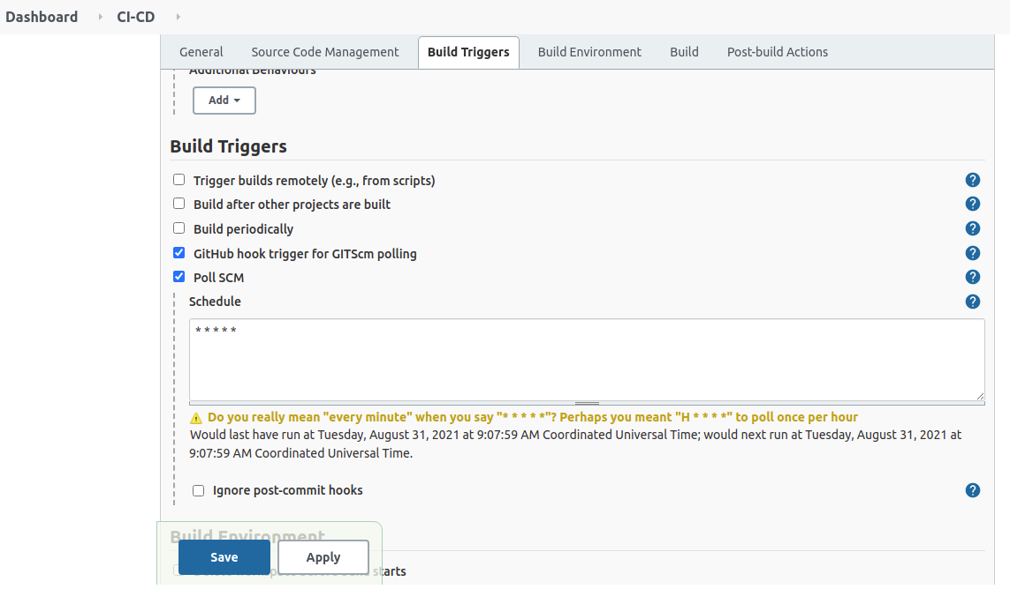
Used to Schedule the Build Time

Slide 18
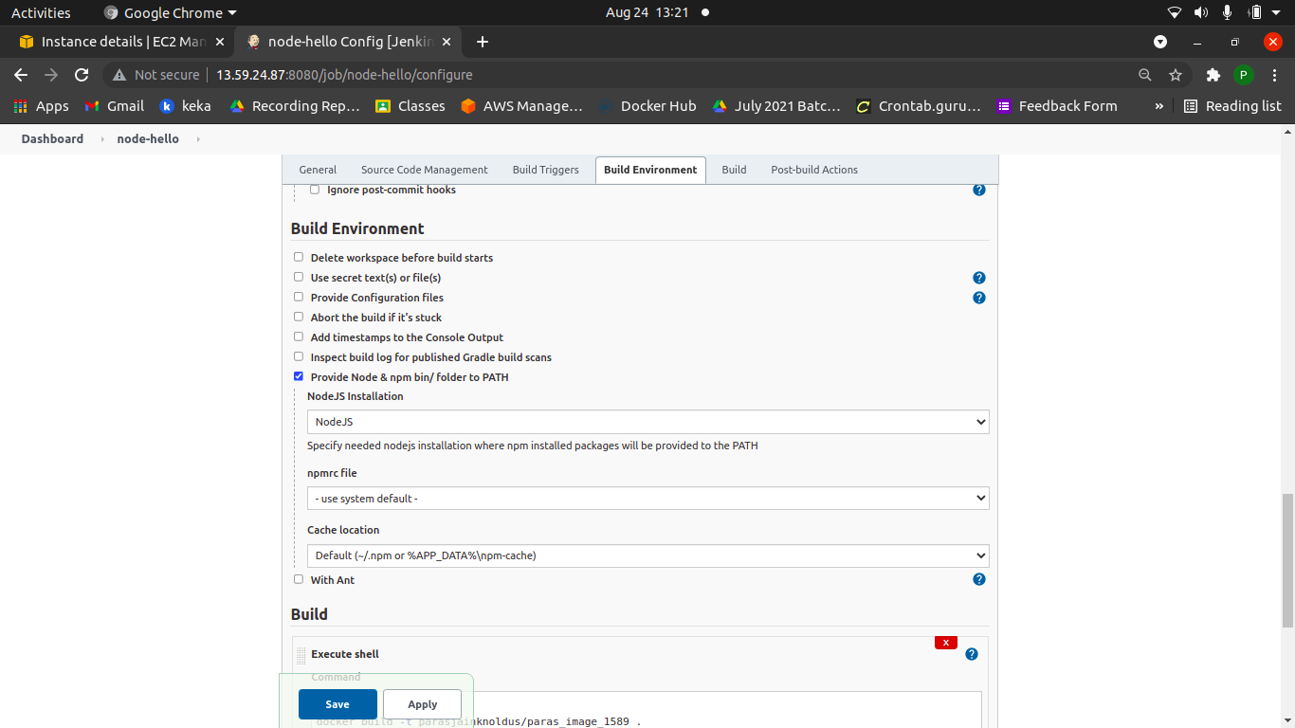
Adding Node JS Build Environment.

Slide 19
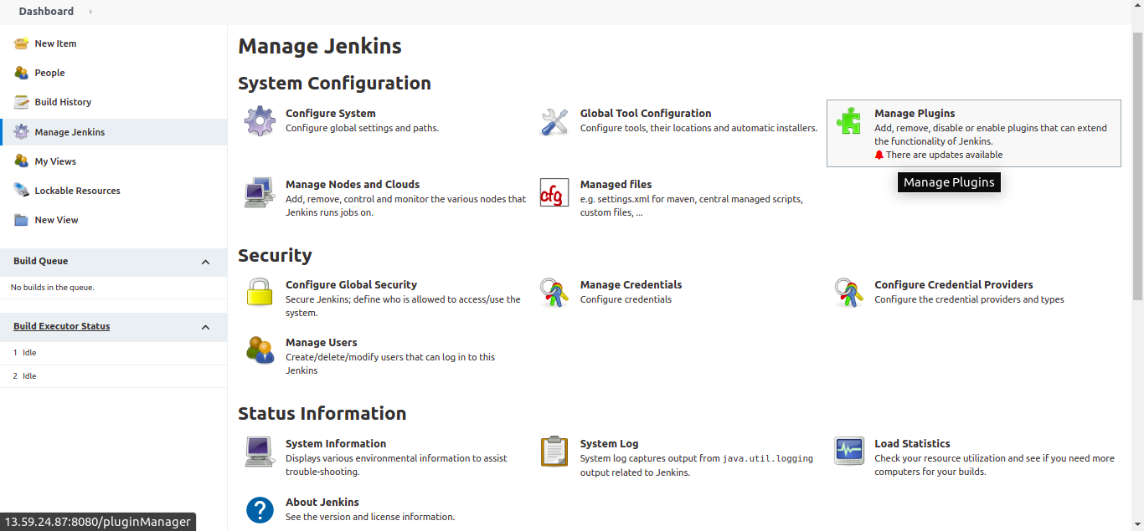
Plugin Configuration

Slide 20
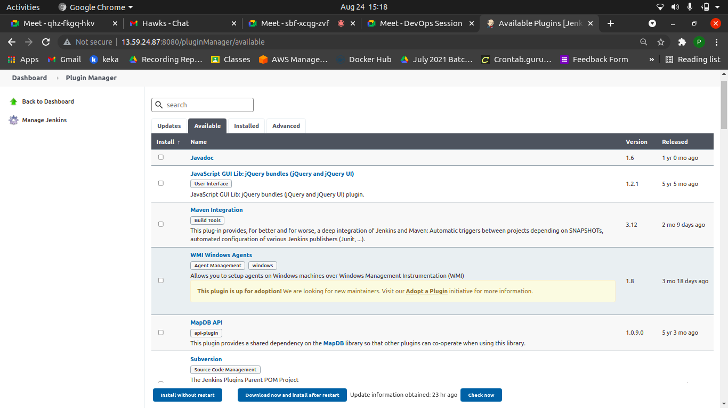
Plugin
Search a plugin Name.

Slide 21
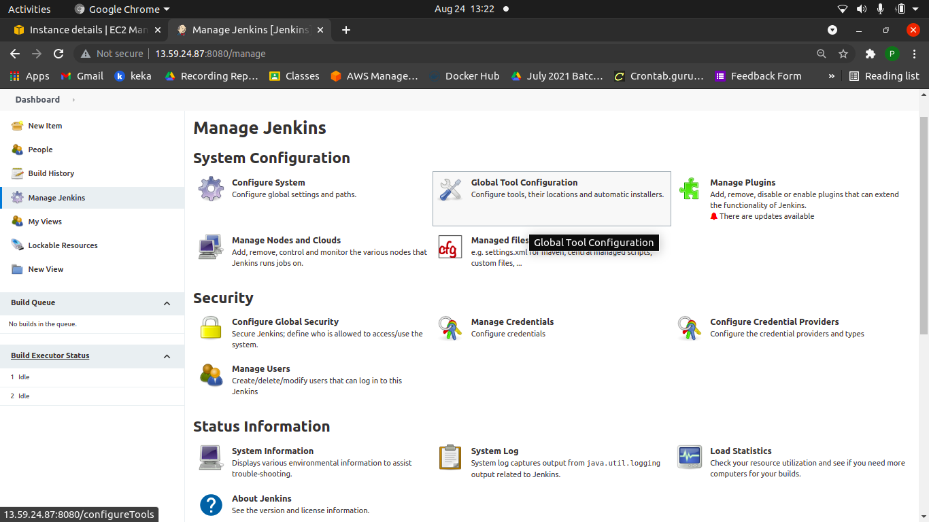
Tool Configuration

Slide 22
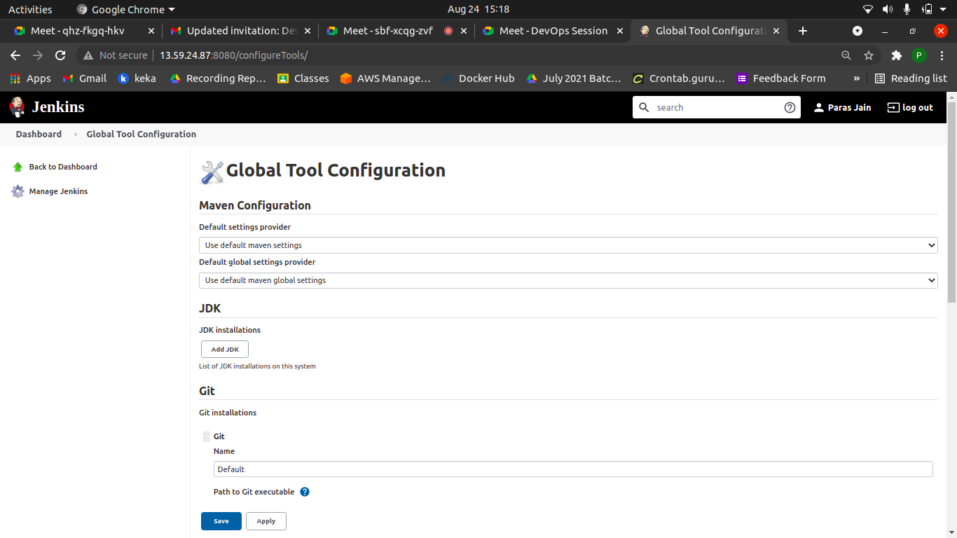
Configure Installed Plugin
Configure the Installed Plugin

Slide 23
Build Environment

Slide 24
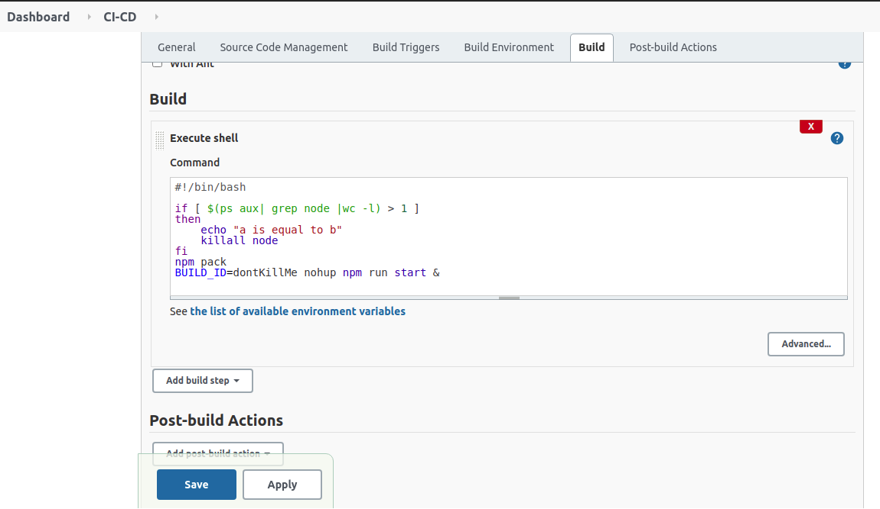
Pipeline Execute Shell
Shell Commands

Slide 25
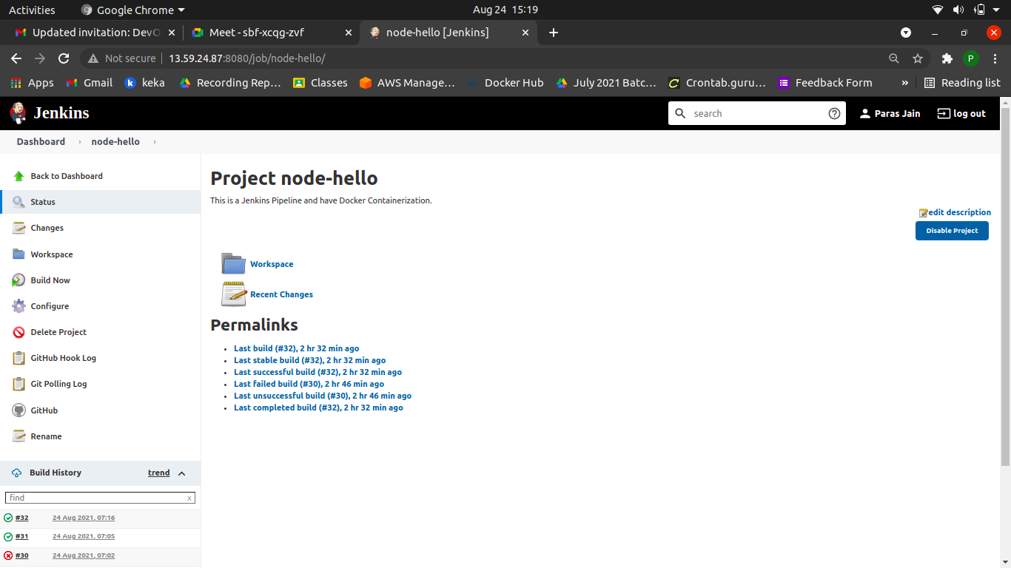
Project node-hello
Click it to build the Project.

Slide 26
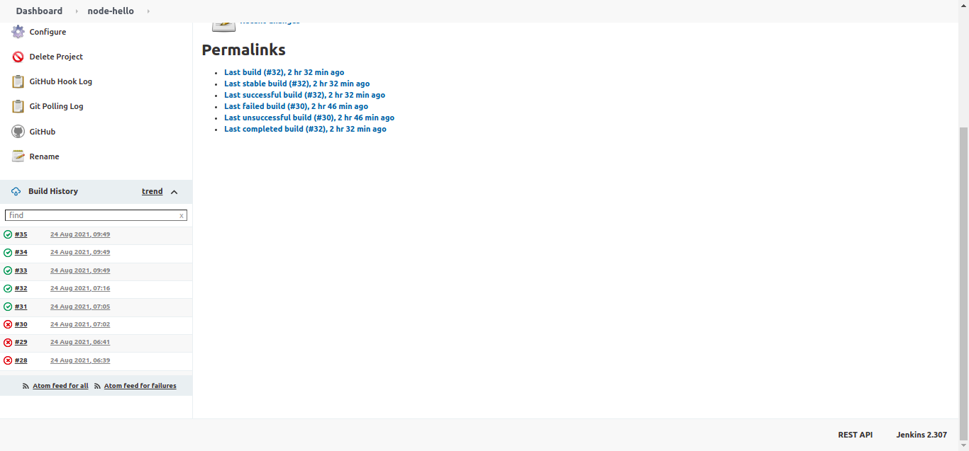
Business Success Model
Build Log Or Build History

Slide 27
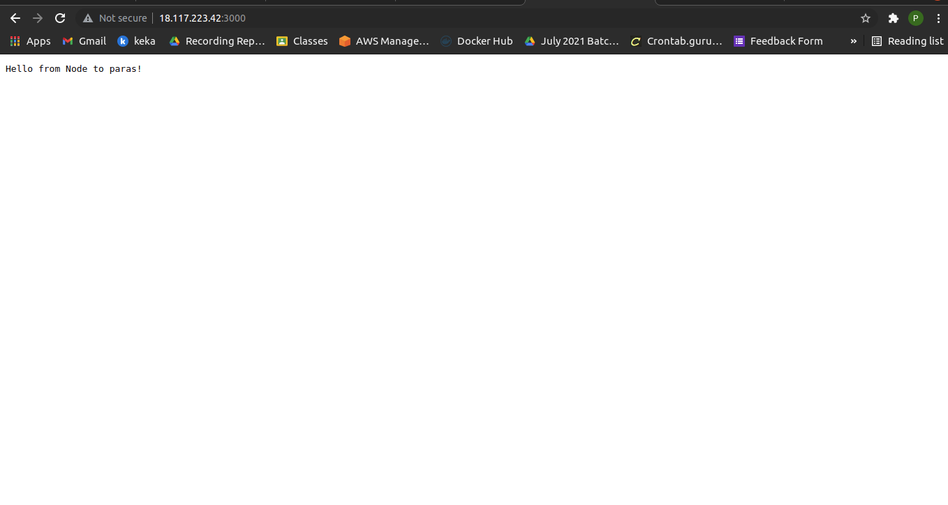
Port
This is 3000 port.

Slide 28
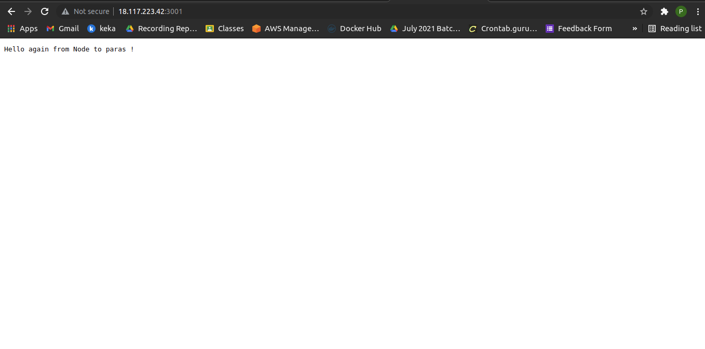
This is 3001 port.

Slide 29
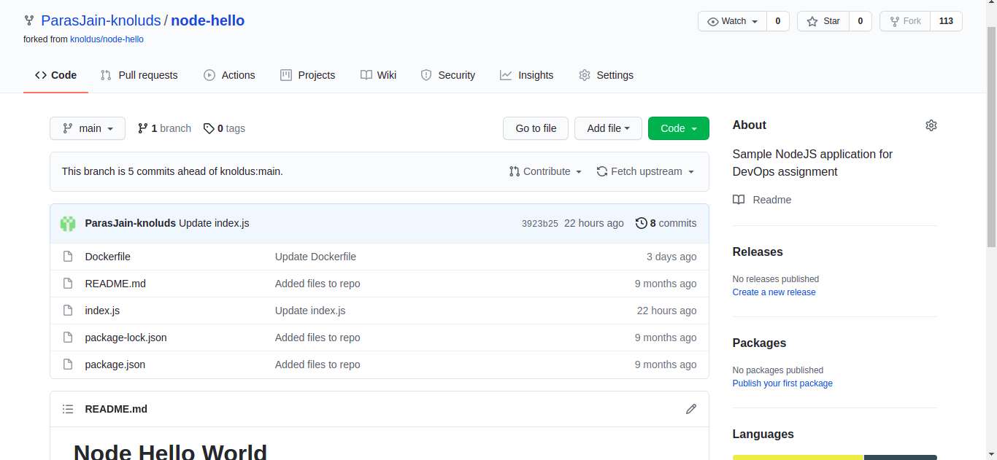
Git Hub Directory

Slide 30
Thank You

